Slide 1
Food Delivery Data Analysis System
Third Review
Cleaning, Visualization and Prediction Models
K. Jaswanthi 25B11AI619
K. Pravallika 26B21AI052
Ch. Siri Varshini 26B21AI017
J. Roshini Sai Deekshitha 25B11AI418
Department
Department of Artificial Intelligence & Machine Learning

Slide 2
Proposal System
Raw dataset
Cleaning
EDA and charts
Prediction
Evaluation
50,000 orders
Duplicates and nulls
Patterns and insights
4 ML models
Accuracy, R², MAE
Review 1 proposed a Python workflow to load, clean, analyse and visualize food-order data.
Review 2 implemented cleaning, EDA and charts on the real dataset.
Review 3 adds prediction models (Review 1 future scope) and measures their accuracy.

Slide 3
Abstract
The Food Delivery Data Analysis System is a Python project that analyses 50,000 food-delivery orders: city, cuisine, restaurant, order value, distance, delivery time, rating, payment and status.
Pandas and NumPy clean the data; Matplotlib shows cuisine, payment, city and status patterns.
Scikit-learn models predict delivery time and order status, scored with R², MAE and accuracy.
Result: a complete pipeline from raw CSV to insights and predictions.
49,000
unique records (from 50,000 raw)
11
columns analysed
4
prediction models

Slide 4
Problem Statement
Food delivery platforms collect huge order data, but manual analysis is slow, error-prone and hides patterns. We need to clean the data, find what drives orders, and predict delivery performance.
Demand
Delivery time
Which cuisines, cities and payment methods drive orders?
How do distance and order value affect delivery time?
Ratings
Order status
How do delivery time and price relate to customer rating?
Can we predict if an order is delivered, cancelled or pending?

Slide 5
Dataset Details: Before and After Cleaning
Before cleaning
After cleaning
50,000
11
49,000
11
rows
columns
rows
columns
1,000
0
0
0
duplicate rows
missing values
duplicate rows
missing values
Fields: Order ID, customer age, city, cuisine, restaurant, order value, distance, delivery time, customer rating, payment method, order status.

Slide 6
Missing Values and Duplicate Records
0
How we handled them
Checked nulls column by column with isnull().sum(); the total was 0, so no imputation was needed.
Counted exact duplicate orders with duplicated().sum() and found 1,000 repeated rows.
Removed them with drop_duplicates(), keeping the first copy of each order.
Re-checked shape, nulls and duplicates: 49,000 rows, 0 nulls, 0 duplicates.
If nulls existed: median for numeric columns, mode for categorical columns.
missing values in all 11 columns
1,000
duplicate rows (2% of 50,000)
49,000
unique rows after removal

Slide 7
Code Step by Step: Loading and Cleaning
1
Load: read_csv reads the 50,000 orders into a DataFrame.
import pandas as pd
df = pd.read_csv(
"food_delivery_dataset_50000.csv")
print(df.shape) # (50000, 11)
print(df.isnull().sum()) # all 0
print(df.duplicated().sum()) # 1000
df = df.drop_duplicates()
print(df.shape) # (49000, 11)
2
Shape: Confirms 50,000 rows and 11 columns.
3
Nulls: isnull().sum() gives 0 missing in every column.
4
Duplicates: duplicated().sum() counts 1,000 repeats.
5
Remove: drop_duplicates() leaves 49,000 clean rows.

Slide 8
Code Step by Step: Analysis and Charts
1
Count: value_counts() counts orders per category.
import matplotlib.pyplot as plt
df["Cuisine"].value_counts().plot(
kind="bar")
plt.title("Orders by Cuisine")
plt.show()
df["Payment_Method"].value_counts().plot(
kind="pie", autopct="%1.1f%%")
plt.show()
df["City"].value_counts().head()
df["Order_Status"].value_counts()
2
Bar chart: Compares cuisines side by side.
3
Pie chart: Shows each payment method's share.
4
City ranking: head() lists the top demand cities.
5
Status: Counts delivered, cancelled and pending.

Slide 9
Expected Outputs vs Actual Outputs
Output | Expected (Review 1) | Actual (Review 3)
Dataset information | Shape and data types | 50,000 rows x 11 columns
Missing-value report | Nulls per column | 0 missing values
Cleaned dataset | No duplicates | 49,000 unique rows
Food category analysis | Most popular cuisine | Biryani: 10,714 orders
Payment analysis | Most-used method | UPI: 23,619 orders
City analysis | Highest-demand city | Warangal: 8,309 orders
Order status | Largest status group | Delivered: 42,290 orders

Slide 10
Prediction Models
Task A: Predict delivery time
Task B: Predict order status
Regression | 80% train, 20% test
Classification | 80% train, 20% test
Linear Regression (baseline)
Random Forest Regressor
Logistic Regression (baseline)
Random Forest Classifier
Features: distance, order value, customer age, city, cuisine, payment method
Features: distance, order value, delivery time, rating, city, cuisine

Slide 11
Prediction Code Step by Step
1
Encode: get_dummies turns text columns into numbers.
from sklearn.model_selection import train_test_split
from sklearn.ensemble import RandomForestRegressor
X = pd.get_dummies(df[feats], drop_first=True)
y = df["Delivery_Time"]
X_tr, X_te, y_tr, y_te = train_test_split(
X, y, test_size=0.2, random_state=42)
model = RandomForestRegressor(
n_estimators=100, random_state=42)
model.fit(X_tr, y_tr)
pred = model.predict(X_te)
2
Split: 80% to learn, 20% to test.
3
Train: fit() learns patterns from training rows.
4
Predict: predict() estimates unseen test rows.
5
Score: Compare pred with y_te (next slide).

Slide 12
Accuracy Details
Task A: delivery time (regression)
Model | R² score | MAE (min) | RMSE (min)
Linear Regression | ___ | ___ | ___
Random Forest Regressor | ___ | ___ | ___
Task B: order status (classification)
Model | Accuracy | Precision | Recall | F1
Logistic Regression | ___ | ___ | ___ | ___
Random Forest Classifier | ___ | ___ | ___ | ___
Values come from the review3_models.py output. Higher R², accuracy and F1 are better; lower MAE and RMSE are better.

Slide 13
Visualizations Used and How They Work
Chart | Code used | What it shows
Bar: orders by cuisine | value_counts().plot(kind="bar") | Most popular food: Biryani
Pie: payment methods | value_counts().plot(kind="pie") | Share of UPI, cash, card, wallet
Bar: orders by city | City.value_counts().plot(kind="bar") | Demand by city: Warangal highest
Bar: order status | Order_Status.value_counts().plot(kind="bar") | Delivered, cancelled, pending
Actual vs predicted | plt.scatter(y_te, pred) | How close predictions are to real times
Feature importance | model.feature_importances_ | Which inputs drive predictions

Slide 14
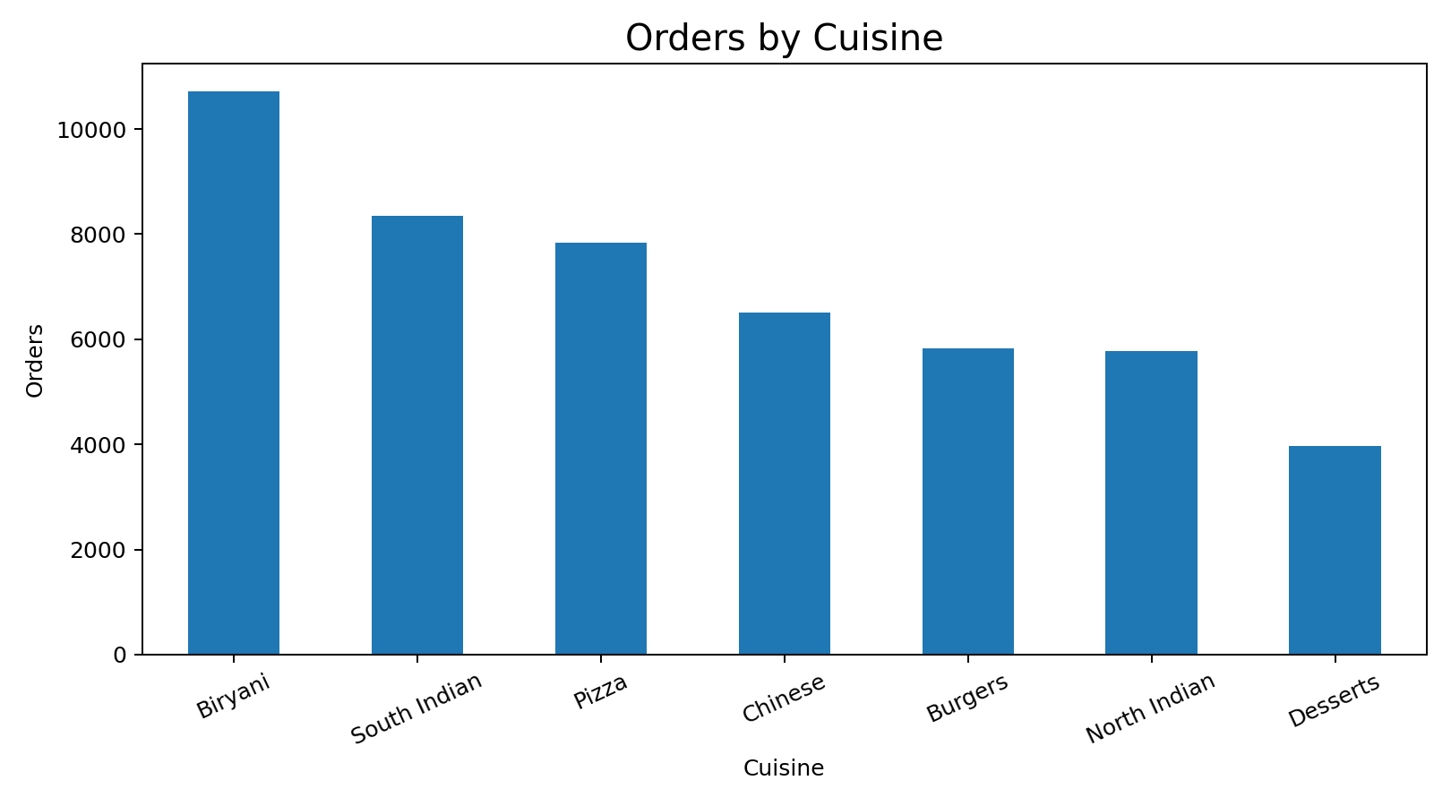
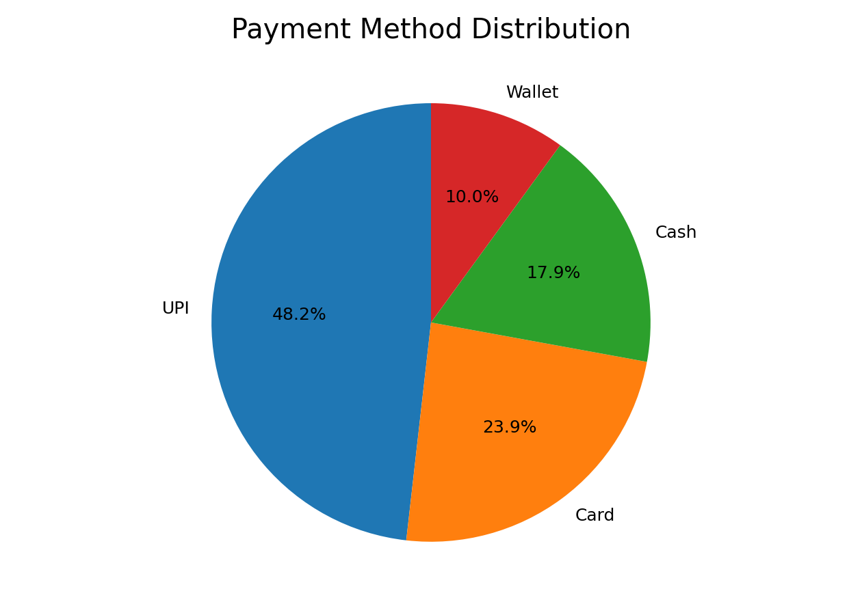
Visualization Outputs
Cuisine bar chart. Biryani leads with 10,714 orders, so menu and stock planning should favour it.
Payment pie chart. UPI is the most-used method with 23,619 orders, so digital payments matter most.

Slide 15
Conclusion
Raw data was cleaned: 50,000 rows became 49,000 unique rows with 0 nulls.
EDA and charts showed Biryani, UPI, Warangal and Delivered orders as the top groups.
Prediction models estimate delivery time and order status and are scored with standard metrics.

Slide 16
THANK YOU

